Slide 1
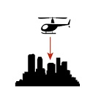
Tablets in Schools (TIS) Project. A Synopsis

Slide 2
PROJECT PARTICIPANTS

Slide 3
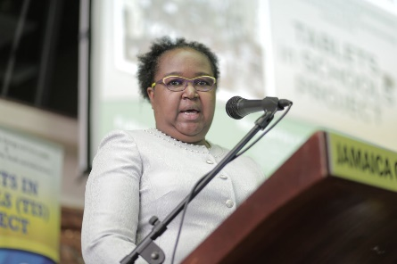
PROJECT OWNER
Ministry of Education, Youth & Information (MOEYI)

Slide 4
PROJECT FUNDING
Ministry of Science, Energy & Technology (MSET)
Via
Universal Service Fund (USF)
Notes:
What USF does - collect and manage the service levy on inbound international calls from companies operating in the local telecommunications sector…
Mandated to ensure access to information and communication tools to facilitate development.

Slide 5
PROJECT PLANNING and EXECUTION
MSET
through
e-Learning Jamaica Co. Ltd. (e-LJam)
&
USF
Notes:
Ministry of Science, Energy and Technology. e-Learning Jamaica & Universal Service Fund

Slide 6
School Readiness Assessment and Remediation
MOEYI via
Building Officers ,NET, Schools/Contractors
MSET via e-LJam & USF

Slide 7
PROJECT VENDORS & SERVICE PROVIDERS
TABLETS | 2 - 4
Laptops & Audio Visuals | 1 - 2
Classroom Management Software | 1
Broadband Internet | 3
Wi-Fi | 2 - 5
Training & Professional Development | 2
School Infrastructure Upgrade | School/MOEYI
Evaluation | 1

Slide 8
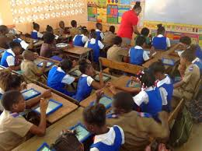
PROJECT IMPLEMENTATION
MOEYI
Via
SCHOOLS (1,106)

Slide 9
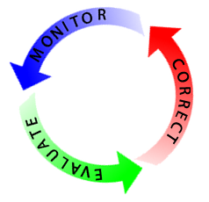
PROJECT BENEFITS REALIZATION MANAGEMENT
MOEYI via
Regional Offices & Schools
MSET via e-LJam

Slide 10
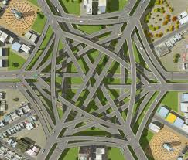
PROJECT Interconnections/Interactions
COMPLEX!

Slide 11
BACKGROUND - PREVIOUS PROJECTS
HIGH SCHOOL PROJECT
outfitted 203 educational institutions including high schools and colleges with computer and audio-visual equipment, local area networks and internet connectivity
acquired and produced digitized instructional materials for 12 CXC CSEC subjects, 2 CAPE subjects and Basic Math, housed in a Virtual Learning Environment (VLE) on the Internet
trained school teachers and lecturers in Teachers’ Colleges
203
12 CXC
VLE
1,000s

Slide 12
BACKGROUND - PREVIOUS PROJECTS
TIS PILOT PROJECT
12 High Schools
18 Primary/All Age
6 Infant/Basic
1 Special School
1 Teachers’ college
38 Schools

Slide 13
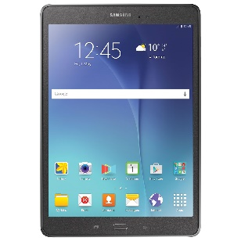
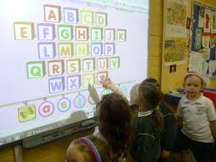
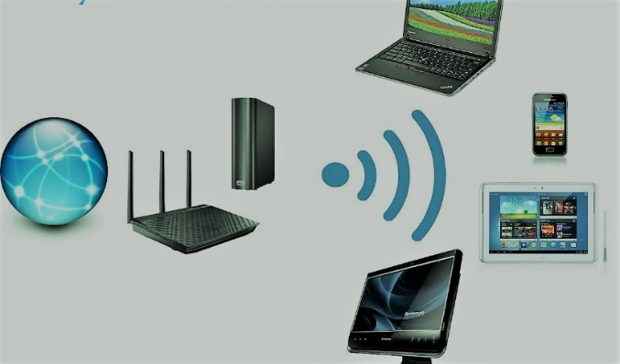
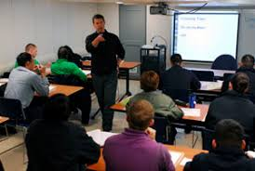
BACKGROUND - PREVIOUS PROJECTS
TIS PILOT PROJECT
Individual tablet computers allocated full time to all teachers and students
Audio Visual equipment and Laptop computers provided to schools
Broadband internet and campus-wide Wi-Fi connectivity
Teachers trained in Basic ICT and Technology Integration
Follow up targeted Professional Development

Slide 14
BACKGROUND - PREVIOUS PROJECTS
TIS PILOT PROJECT – Lessons Learned
LESSONS LEARNED | RESPONSE
Funding source inadequate to provide 1:1 tablet allocation to students in all schools. | Allocate tablets to schools for shared use 20% of time Continue 1:1 for teachers for research and lesson preparation
The critical importance of access to content and the difficulty in providing reliable broadband internet connectivity of the required capacity needed to enable this in some areas of the country. | Work closely with ISPs to get the best possible deal Use local content or cache servers to augment response time
Higher than expected level of damage to tablets, especially in high schools. | Most incidents of damage happen outside of school – Tablets to be securely stored at the schools

Slide 15
BACKGROUND - PREVIOUS PROJECTS
TIS PILOT PROJECT – Lessons Learned
LESSONS LEARNED | RESPONSE
Inappropriate use of tablets and breaches of the security provisions by students. | Classroom Management Software Stricter content filtering at each school
High cost of Mobile Device Management Systems vs the low incidence of theft | Use Google apps for Education Schools must provide physical security
Better adoption of the project at lower grade levels in the schools. | Focus TIS Rollout at infant and Primary levels

Slide 16
BACKGROUND - PREVIOUS PROJECTS
TIS PILOT PROJECT – Lessons Learned
LESSONS LEARNED | RESPONSE
Role of the teacher is absolutely vital | Include all teacher training institutions in the first phase of the roll out
It takes time to realize the benefits | Extend the monitoring and Professional development to two years

Slide 17
Lessons Learned
VISION
LEADERSHIP
TEAMWORK
STICK-TO-IT-IVENESS

Slide 18
TIS ROLLOUT PROJECT - OUTPUTS
ITEM | QUANTITY
Teachers Trained | 12,500
Tablets | 91,000
Charging Carts | 2,000
Interactive Whiteboard Solutions | 2,200
Multi Media Projectors | 4,400
Laptops | 4,500
Internet Connections | 1,106
Wi-Fi Access Points | As needed
Local Servers | 1,106
Classroom Management Software | 91,000
Educational Content | Many

Slide 19
TIS ROLLOUT PROJECT - INPUTS
Cost | J$7.9B
Time | 11 Years
September 12, 1962
July 20, 1969
Notes:
This cost does not include connectivity or technology refresh! This is a very long time for such a project. Compare with other well known major projects. Possible consequence! Money is the problem!Need for performance

Slide 20
TIS ROLLOUT PROJECT - INPUTS
Cost | J$7.9B
Time | 11 Years
WHY?
Notes:
This cost does not include connectivity or technology refresh! This is a very long time for such a project. Compare with other well known major projects. Possible consequence! Money is the problem!Need for performance

Slide 21
TIS ROLLOUT PROJECT - INPUTS
Cost | J$7.9B
Time | 11 Years
WHY?
Money $$!
Notes:
This cost does not include connectivity or technology refresh! This is a very long time for such a project. Compare with other well known major projects. Possible consequence! Money is the problem!Need for performance

Slide 22
TIS ROLLOUT PROJECT - INPUTS
Cost | J$7.9B
Time | 11 Years
WHY?
Money $$!
Notes:
This cost does not include connectivity or technology refresh! This is a very long time for such a project. Compare with other well known major projects. Possible consequence! Money is the problem! Need for performance

Slide 23
PROJECT EVALUATION – PROCESS, OUTPUTS & OUTCOMES
Scrutineers, Auditors and Gatekeepers
MOEYI
E-LJam
OPM
MSET
Office of the Contractor General
Auditor General

Slide 24
TIS ROLLOUT PROJECT – This Phase
OUTPUTS
Teachers Trained | 3,000
Tablets | 16,000
Charging Carts | 350
Interactive Whiteboard Solutions | 580
Multi Media Projectors | 1,160
Laptops | 800
Internet Connections | 193
Wi-Fi Access Points | As needed
Local Servers | 193
Classroom Management Software | 16,000
Educational Content | Many

Slide 25
TIS ROLLOUT PROJECT – This Phase
INPUTS
Cost | J$1.5B
Time | 2 Years
Notes:
This cost does not include connectivity or technology refresh! This is a very long time for such a project. Compare with other well known major projects. Possible consequence! Money is the problem!Need for performance

Slide 26
TIS ROLLOUT – PHASE 1
All Equipment Delivered
8/10/2018
List Finalized
School Starts
11/10/2017
9/3/2018
Phase End
Funding Available
Place Order for Class sets
Deed of Gift signed
8/7/2017
2/5/2018
9/21/2018
8/31/2020
2017
Jan
May
Sep
2018
May
Sep
2019
May
Sep
2020
May
2020
Today
169 days
Upgrade School Infrastructure
11/13/2017 - 4/30/2018
347 days
Internet and Wi-Fi Procurement and installation
8/8/2017 - 7/20/2018
192 days
Tablet and Audiovisual Equipment Procurement
8/9/2017 - 2/16/2018
131 days
Equipment Delivery
4/2/2018 - 8/10/2018
327 days
Training
10/16/2017 - 9/7/2018
26 days
Confirm School Readiness
4/30/2018 - 5/25/2018
698 days
Onsite Implementation Support and Professional Development
9/3/2018 - 7/31/2020
991 days
Plan, Implement and continually review ICT Integration
11/14/2017 - 7/31/2020
1034 days
Baseline, Process and Outcome Evaluation
10/2/2017 - 7/31/2020
1096 days
Public Education
8/1/2017 - 7/31/2020

Slide 27
STAKEHOLDER ENGAGEMENT
School Boards, Principals, Teachers, Students, Parents, Community, MOEYI, USF, ELJAM, Public

Slide 28
PRINCIPALS’
Research - Get all the information you can – Pro & Con
Develop a plan – Be Creative
Engage your staff & PTA early
Collaborate, Share
Observe, Monitor closely – Keep ICT on your meeting agendas
What if in u heart of hearts u don’t believe? – it nah go wok!!

Slide 29
TIS ROLLOUT PROJECT - RISKS
Potential Risk | Impact | Likelihood | Consequence | Mitigation Strategy
Reduction of funding from USF | High | Medium - Low | Longer time to complete project | MOU to be signed with MSET/USF/MOEYI/e-LJam setting out agreed roles and responsibilities and priority of TIS project
Delays in provision of required internet connectivity | High | High | Users unable to access internet based content | Provide local cache and content servers with offline versions of internet resources such as Khan Academy and Wikipedia.

Slide 30
TIS ROLLOUT PROJECT - RISKS
Potential Risk | Impact | Likelihood | Consequence | Mitigation Strategy
Equipment theft from school | Medium - Low | Medium - Low | Loss or reduction of functionality and capability | Strict adherence to readiness criteria which include existence of secure storage at schools; branding/external markings of tablets; public education and community engagement.
Equipment damage | Medium - High | Medium | Reduced capability | Extended warranty; 30% spare tablets to be issued to schools; Upfront contracting for Vendors to keep spares in stock and provide repair services.
Notes:
This cost does not include connectivity or technology refresh! This is a very long time for such a project. Compare with other well known major projects. Possible consequence! Money is the problem!Need for performance

Slide 31
TIS ROLLOUT PROJECT - RISKS
Potential Risk | Impact | Likelihood | Consequence | Mitigation Strategy
Inability of Vendor to perform as contracted | High | Medium | Potential delays, reduction in capability, financial loss | Stringent evaluation criteria for prospective vendors; Use of multiple vendors.
Network-wide Cyber security incident | High | Medium | Disruption of activities due to unavailability of network | User education face to face / social media to keep security in the minds of users; Deployment of firewalls at each site in order to provide the following security functions: intrusion detection/prevention; gateway antivirus; gateway anti-spam; content filtering; data loss prevention.
Notes:
This cost does not include connectivity or technology refresh! This is a very long time for such a project. Compare with other well known major projects. Possible consequence! Money is the problem!Need for performance

